Slide 1
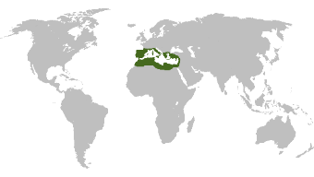
LOCUST BEAN GUM
From seed to table
Sustainable Production
Where does LBG come from?
Naturally sourced
Our site environmental management system
focuses on continuous improvements
All-natural vegetable gum extract
CO₂
CO₂
CO₂
CO₂
CO₂
Carob trees show resistance against drought and prevents soil degradation
Locust bean kernels
are the carob trees fruit seeds
Investing in new efficient equipment for:
Waste reduction
GRINDSTED® LBG acts by retarding crystals grow and undergo recrystallization in ice creams, extending the shelf-life
Carob trees are grown without (or with very little use of) fertilizers and water
Efficient drying system which allows us to work at low temperatures
Moving from standard to green electricity
Consumer friendly
Used by food and baby food manufacturers to improve:
Sourcing from Morocco, Spain, Portugal and other Mediterranean countries
Wastewater is pre-treated to generate biogas
TEXTURE • STABLILITY • FRESHNESS
First ever 3rd party reviewed and ISO 14044 compliant LCA (Life Cycle Assessment) study of LBG
Utilizes all products and
by-products of the production process for pet food, animal feed and human consumption
Spanish Carob
Industry Association
Brings 10,000 grafted carob
plants to Spanish farmers every year
0%
waste
Plant-based protein
GRINDSTED® VEGPRO is based on the LBG germ and offers a balanced amino acid spectrum to replace animal-based proteins
Organic
Sourcing organic kernels
to produce GRINDSTED® LBG Organic
HALAL, KOSHER, and BRC Food Safety Certified

